Slide 1


Workshop 2 PID Control
Welcome to the fascinating world of PID control in robotics! In this workshop, we will delve into the concept of PID control, its components, and how it can enhance system performance.

Slide 2
Introduction
Control Systems
Control systems are an essential component of any system, providing a way to regulate and manage its behavior. By implementing control systems, we can improve the performance and efficiency of various systems, leading to better outcomes.

Slide 3
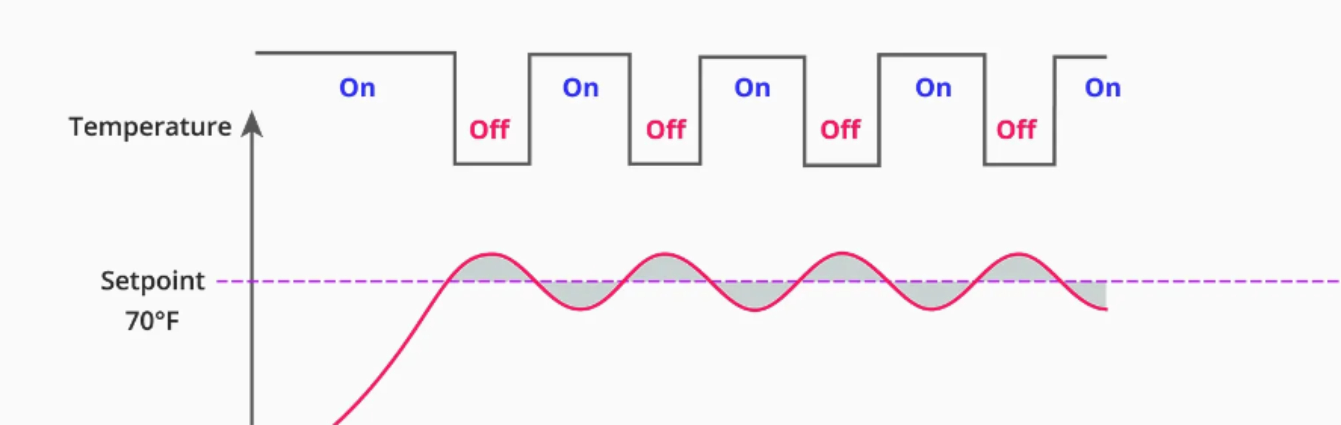
Bang-Bang Control
Bang-bang control is a simple yet effective control strategy used in various systems. It involves toggling between two extreme states, such as on and off, to regulate a system's behavior.

Slide 4
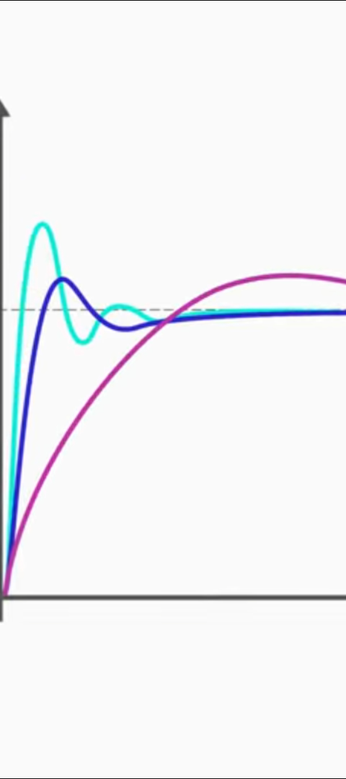
PID Control in a Nutshell
PID control is a feedback control algorithm used in various applications, including robotics. It stands for Proportional, Integral, and Derivative control.
The Proportional term provides an immediate response to the error signal, the Integral term eliminates steady-state error, and the Derivative term predicts the future trend of the error.
By continuously adjusting the control input based on these three components, PID control helps regulate and stabilize systems, improving accuracy, stability, and response time.

Slide 5
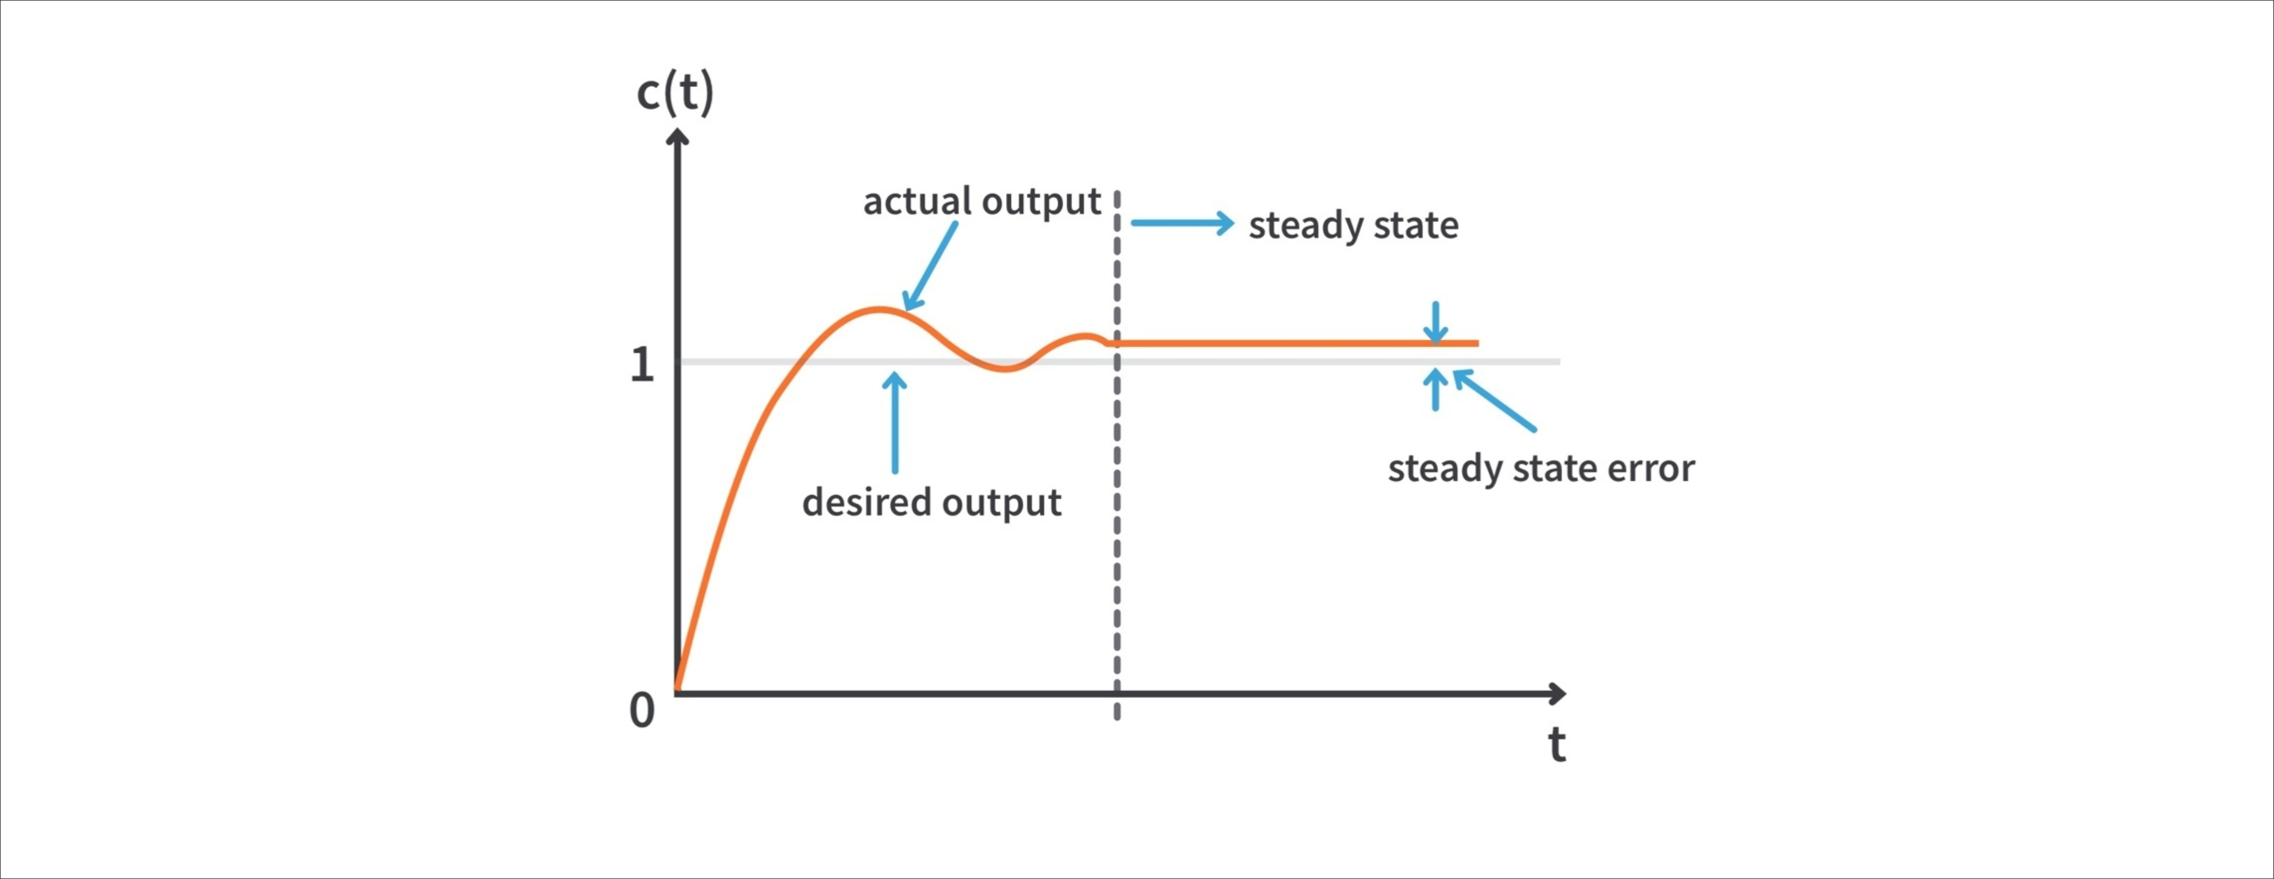
Steady-State Error
1
Understanding Steady-State Error
2
Minimizing Error with PID Control
Steady-state error refers to the difference between the desired output and the actual output of a system once it has reached a stable state.
PID control mechanisms can help reduce or eliminate steady-state error in robotic applications, enabling highly precise control and improved system performance.

Slide 6
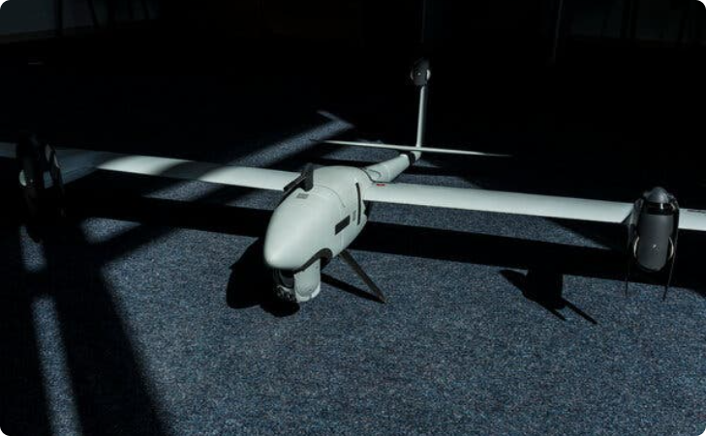
Examples of PID Control
Drone Dynamics
PID control helps ensure stable drone flight by constantly adjusting the speeds of the motors based on sensor feedback. This allows the drone to maintain its intended position in the air, even in the presence of external disturbances like wind or gusts.

Slide 7

Proportional Control in Car Braking
Proportional control is a can be used in car braking systems to regulate the amount of braking force applied based on the difference between the desired and actual speed.
When approaching a bump, the proportional controller measures the difference between the desired stopping speed and the current speed of the car. As the car gets closer to the bump, the controller applies a stronger braking force to ensure a smooth and controlled deceleration.
This proportional control algorithm ensures that the car slows down gradually and smoothly, preventing sudden stops or skidding. It provides a responsive braking action that is proportional to the error between the desired and actual speed.

Slide 8
Tuning the PID Controller
1
Proportional Gain (Kp)
2
Derivative Gain (Kd)
3
Integral Gain (Ki)
The Integral Gain (Ki) eliminates steady-state error, leading to improved system accuracy. Fine-tune Ki to achieve and maintain the desired output.
The Proportional Gain (Kp) adjusts the controller's response to input changes. By finding the right balance, you can prevent sensitivity or sluggishness in the system.
The Derivative Gain (Kd) helps minimize overshoot and stabilize the system. By adjusting Kd, you can improve stability and response time.

Slide 9
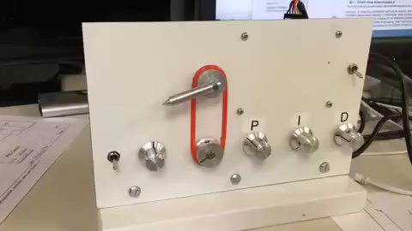
PID Demo

Slide 10
Code + Instructions

Slide 11
THANK YOU

